Slide 1
ENTRY BASED SECURITY SYSTEM
BY TEAM DAUNTLESS
Devansh Kaushik (181322)
Deepak Kumar (181337)
Diwakar Srivastava (181330)
Project Guide
Dr. Geetanjali

Slide 2
CONTENTS
INTRODUCTION
MOTIVATION
LITERATURE SURVEY
PROBLEM STATEMENT
OBJECTIVE
TECHNOLOGIES USED
WORKFLOW CHART
TIMELINE CHART
REFERENCES

Slide 3
INTRODUCTION
IoT alongside AI and ML, has become an emerging field in the technological domain. As these domains come under focus of industries, the domain has opened a new concept in consumer market often termed smart solutions.
With a similar mindset of exploring more of these domains, Team Dauntless has started it’s project based on entry door security, a concept which replaces traditional lock-key system with a lock that opens by recognizing faces and helping you keep an eye at your doorstep using a phone application.

Slide 4
MOTIVATION
With home security as an essential need for every household, we all know how easy is to break the key-lock system that one uses everyday, thinking how that lock wouldn’t let anyone in, behind one’s backs. And yet, every 3 minutes a house gets robbed and the realization of ensuring the safety of our homes is too late.
With keeping this thought as motivation, Team Dauntless has started it’s first project to replace the traditional key-lock system with face recognition-based entry door system, which will not only increase the safety of preventing forced breaks into your homes, but also remove the everyday hassle of keeping a large bunch of keys in your pockets everyday, whenever anyone steps out even for a minute.
Furthermore, as the team will tend to keep majority of its focus on AI/ML and IoT, applying our skill set to a variety of fields such as security will add to the team’s understanding and proficiency.

Slide 5
LITERATURE SURVERY
Title | Author | Techniques used | Performance Analysis | Limitations
Smart Door System for Home Security Using Raspberry pi3 | Naser. Abbas Hussein, Inas Al Mansoori | Wireless connection, Raspberry Pi, camera, keypad | Door access using face recognition or pin. If valid, input door opens; if not photo is sent to owner by email and owner grants permission accordingly. | Once initialized, database can’t be altered. Access control only for a single user.
IOT based Smart Home Security System with Alert and Door Access Control using Smart Phone | Shaik Anwar, D. Kishore | Raspberry Pi, camera, microcontroller, PIR motion | PIR motion detect motion and camera take images and send it via email via TCP/IP, Authorized user can view video stream through smart phone application also send void note. | Authorized user also have to go through verification, without internet door will not open for authorized user
Smart Door Security System using Raspberry Pi with Telegram | Shivani Desai, Virendra D. Pawar | IoT, Telegram, Raspberry Pi, Python, Putty | PIR motion detecting the motion capturing an image as soon as the bell is being pressed and send the image to the android device through telegram app and alert the owner. | Authorized user also have to go through verification, without internet door will not open for authorized user

Slide 6
PROBLEM STATEMENT
01
I am
An apartment owner
02
I’m trying to
Increase security of my apartment
03
but
Key-lock systems are vulnerable
04
because
They are old-fashioned and easy to break-in
05
which makes me feel
What if my smartphone could unlock my apartment for me ?

Slide 7
OBJECTIVE
To increase safety of entry doors by an IoT-based facial recognition system with an integrated application for end user and a real-time database.

Slide 8
TECHNOLOGIES USED
Software: Rasbian OS + Putty, Python3, haar-cascades_frontal_face_detetction, OpenCV, LBPH (recognizer algorithm), Firebase (realtime database + storage),Android Studio
Hardware: Raspberry pi 3 B+, webcam, SD card, cables , 5V 2.5A power supply

Slide 9



WORKFLOW CHART
Sending trainer
models
Push notifications
Videos
Push
notifications
Realtime database + storage (Firebase) + Server
create train model with the video dataset
End user
application
IoT device
(Raspberry)

Slide 10
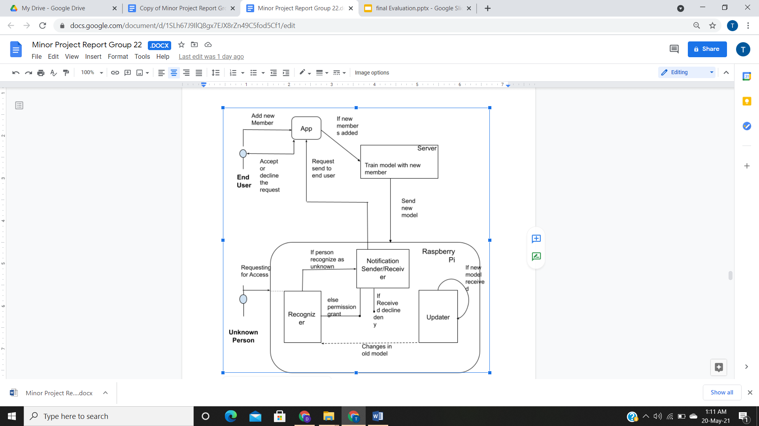
USE CASE DIAGRAM

Slide 11
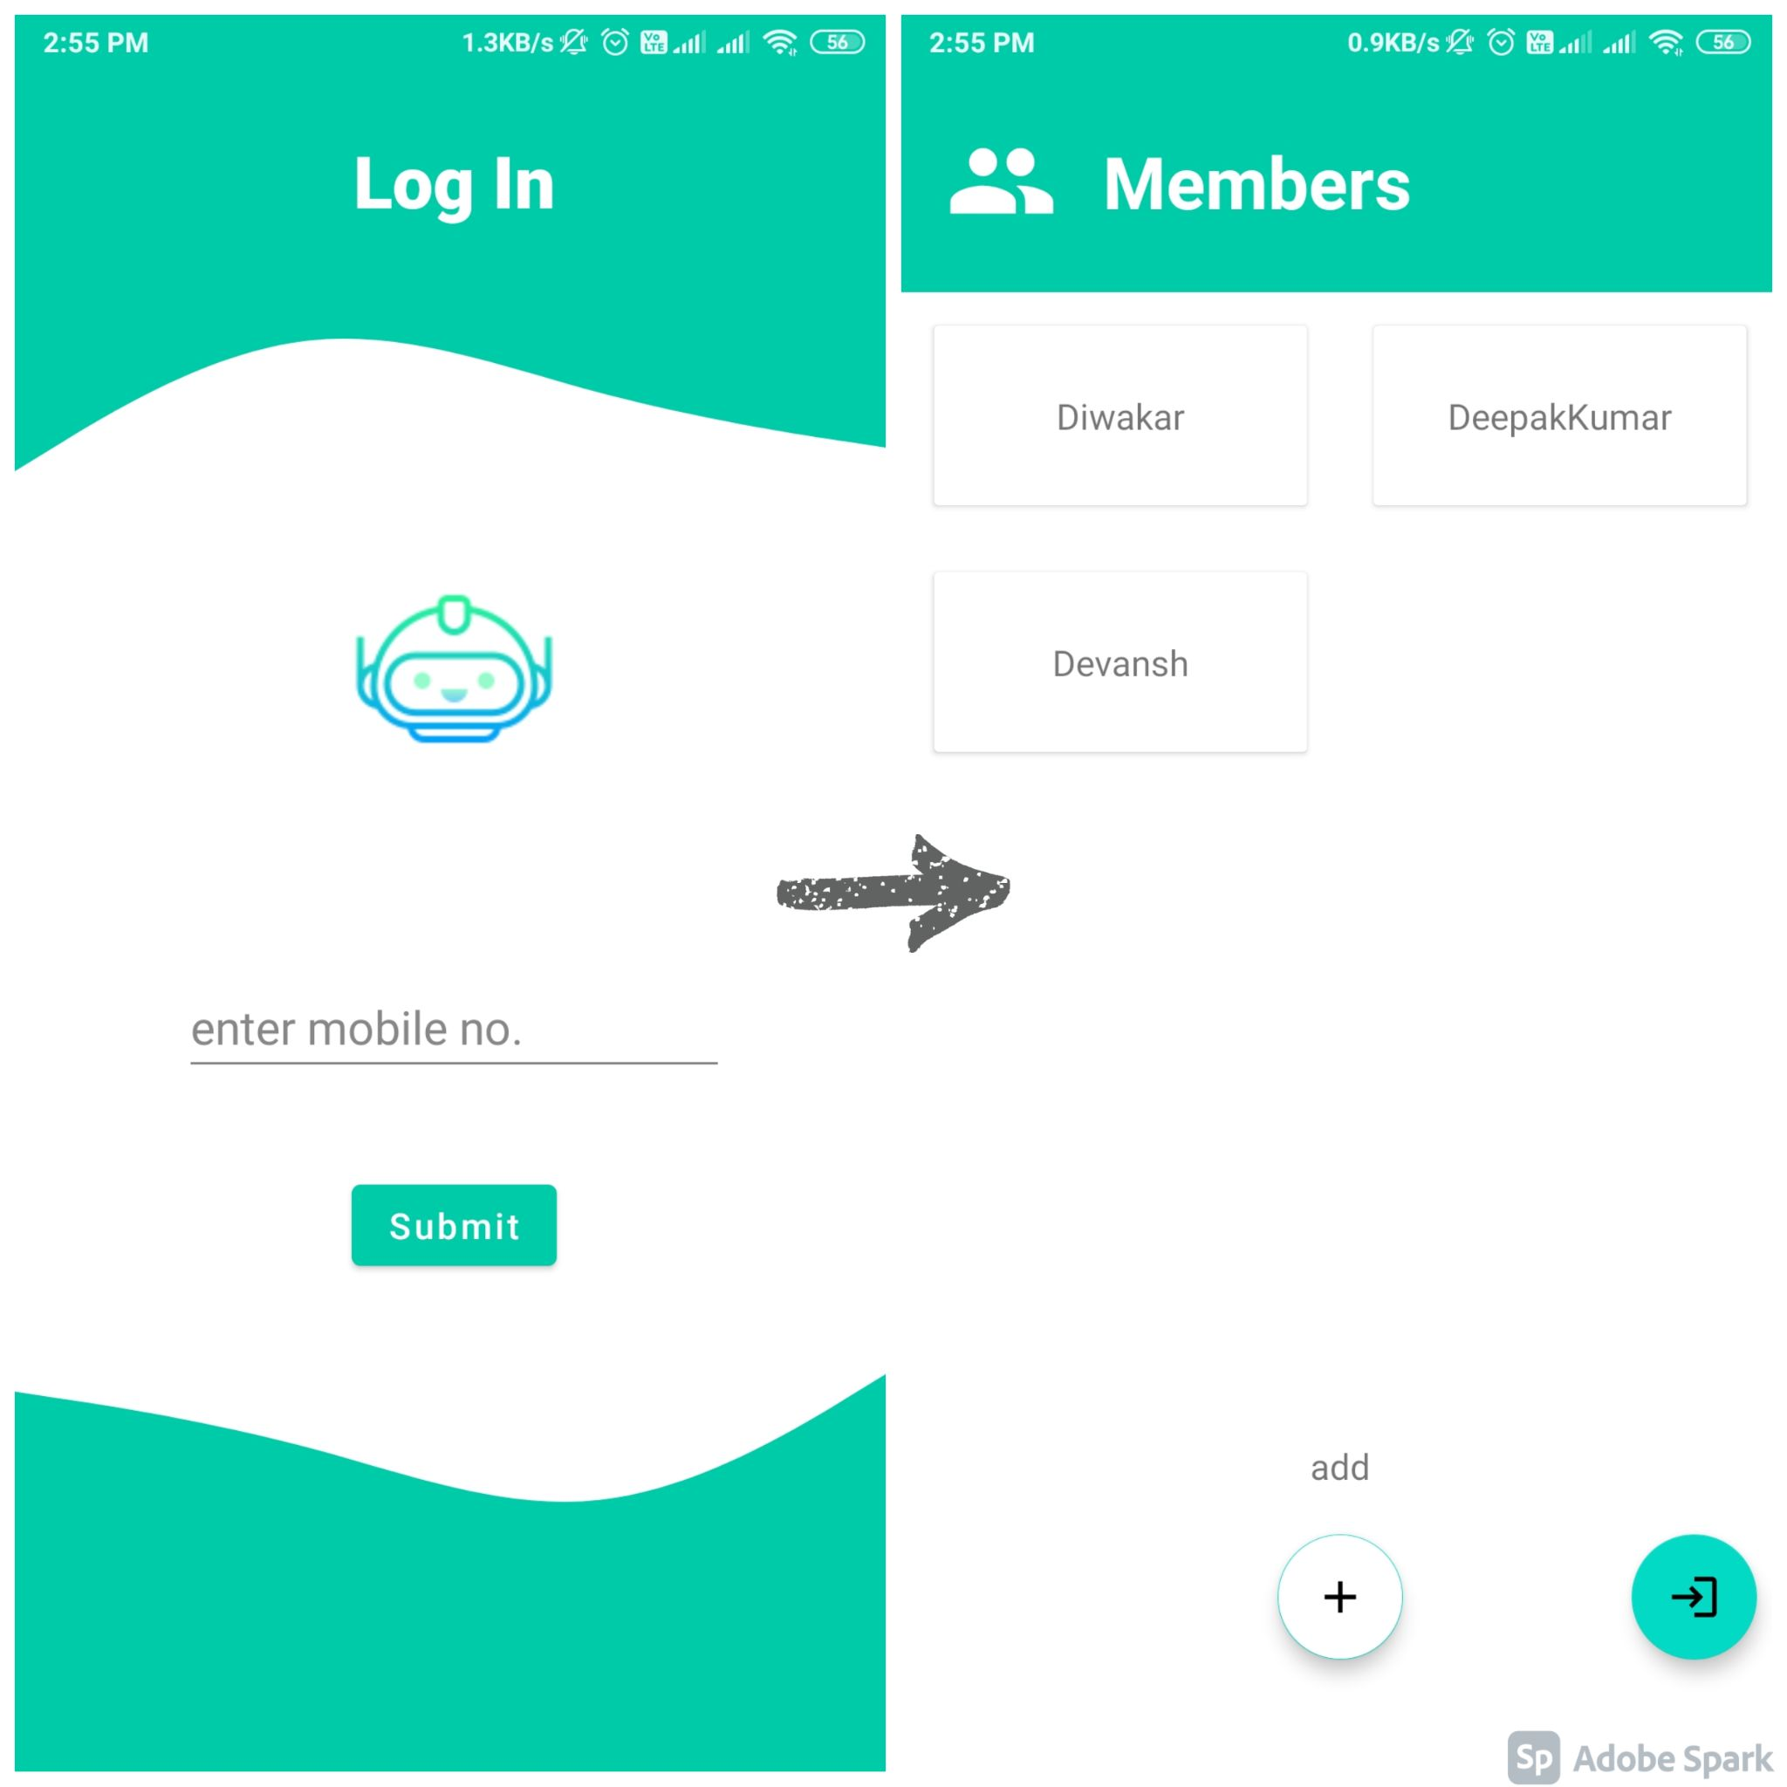
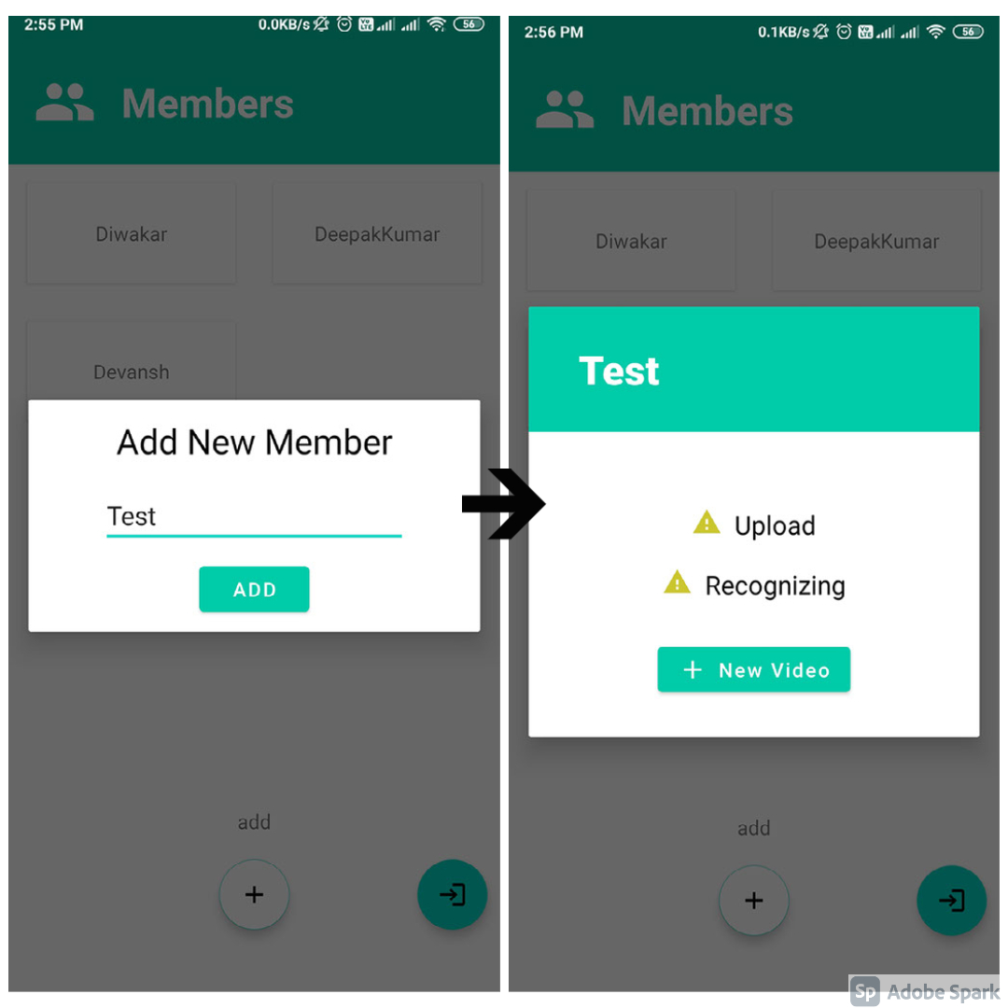
SCREENSHOTS :

Slide 12
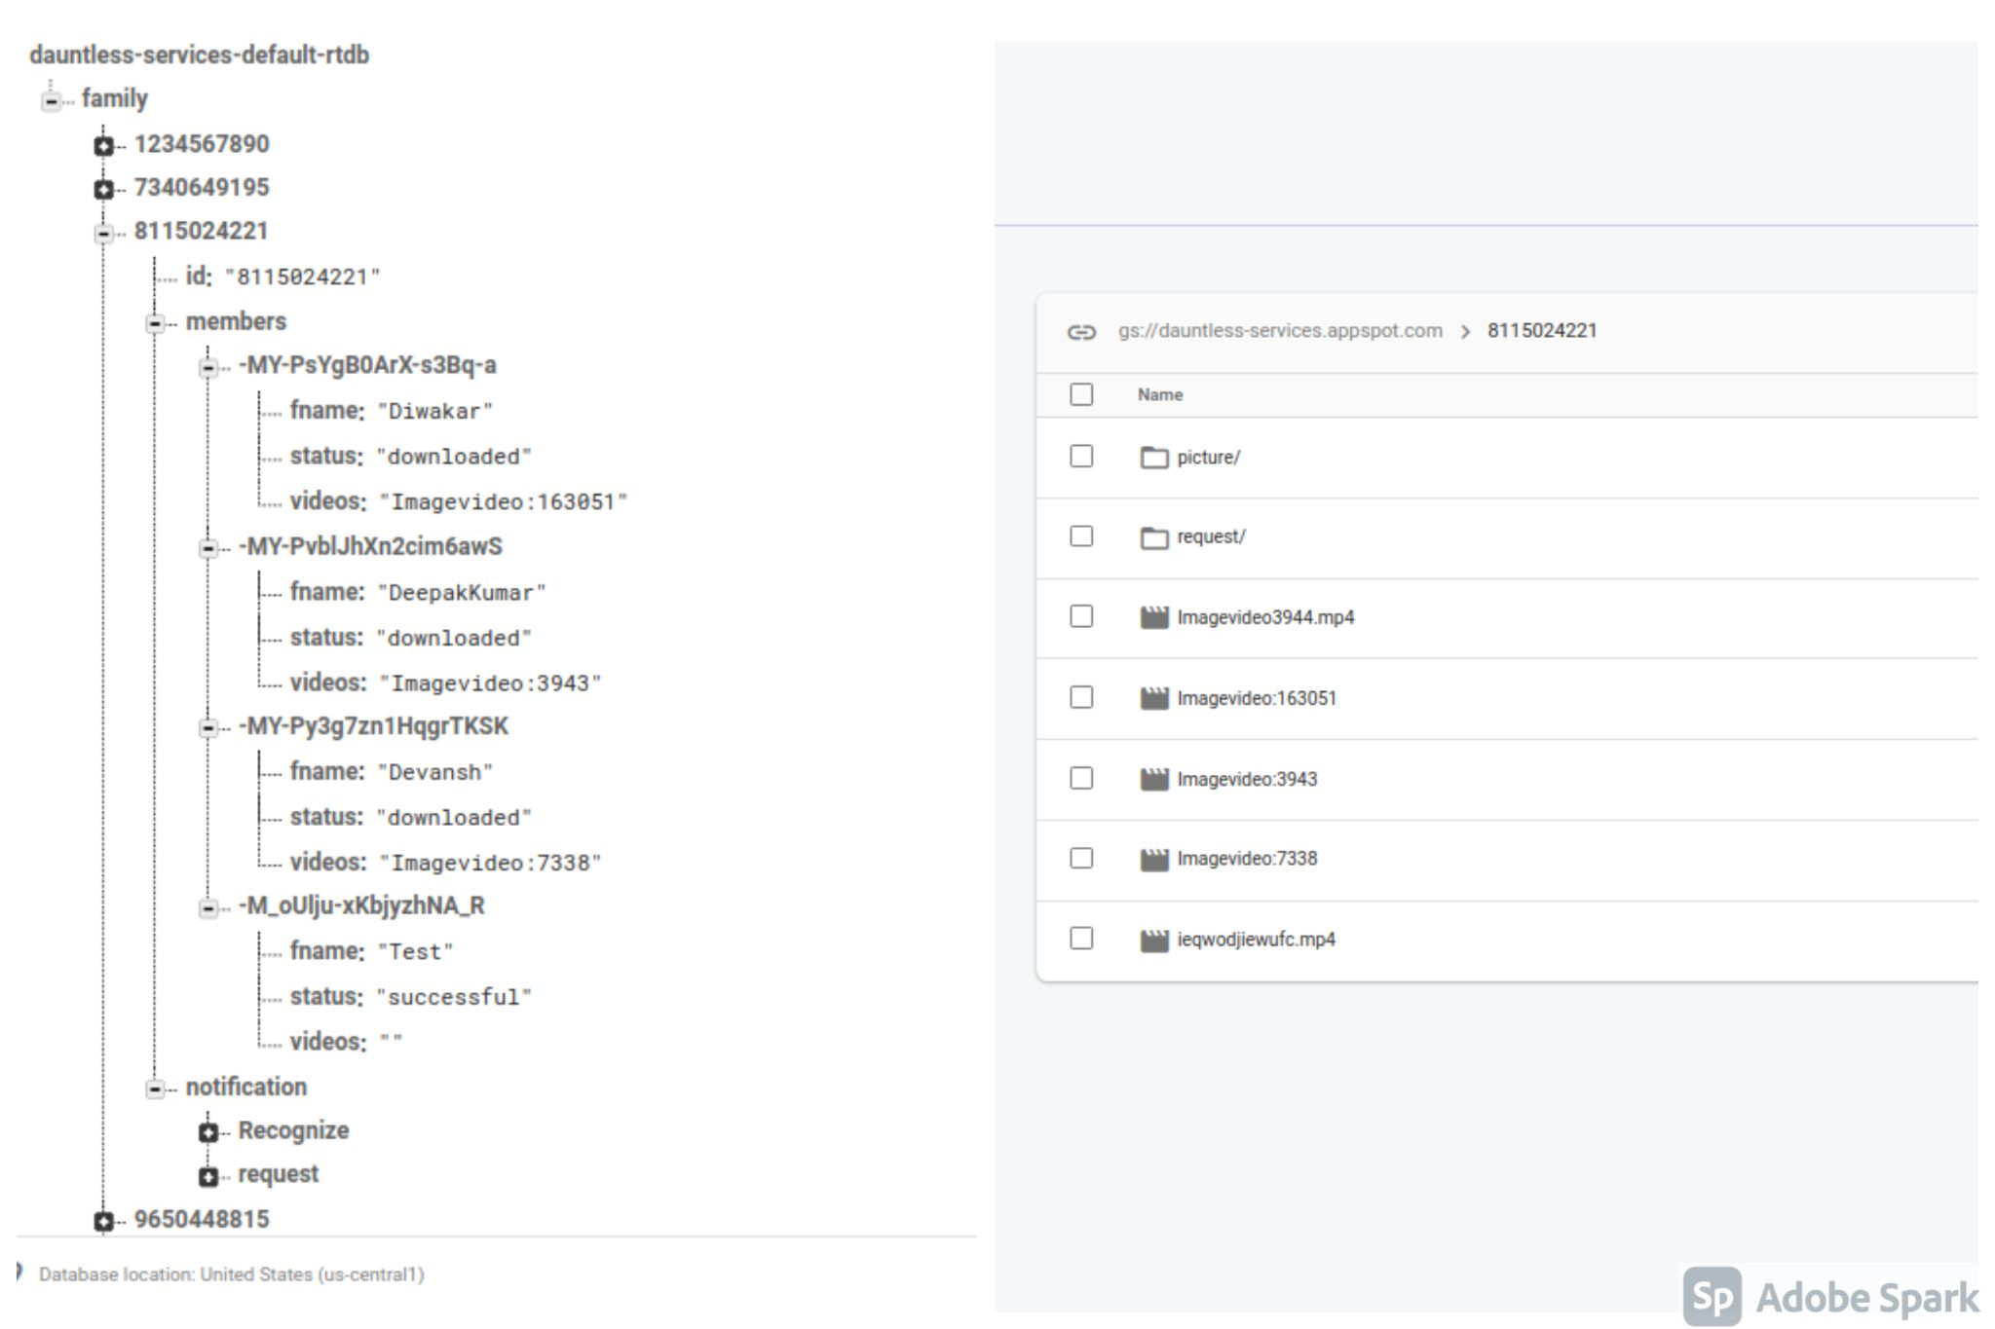

Slide 13
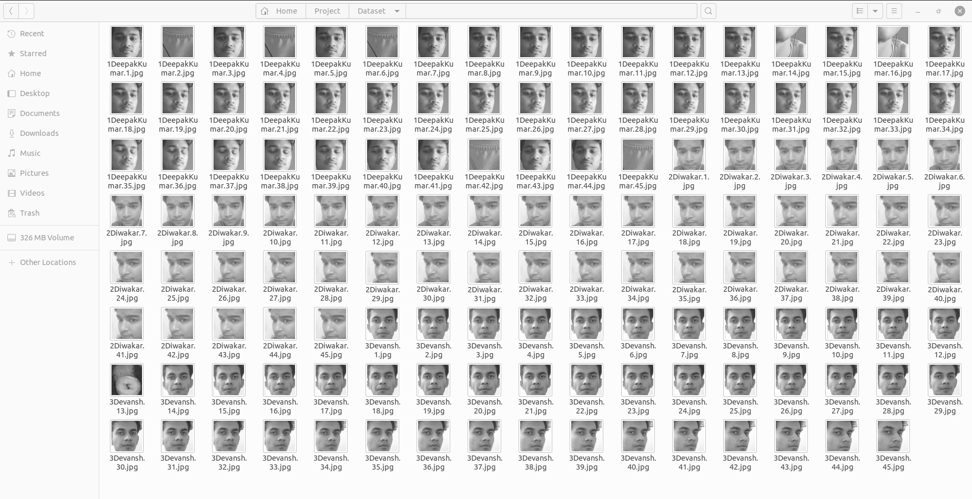
IMAGE CAPTURES

Slide 14
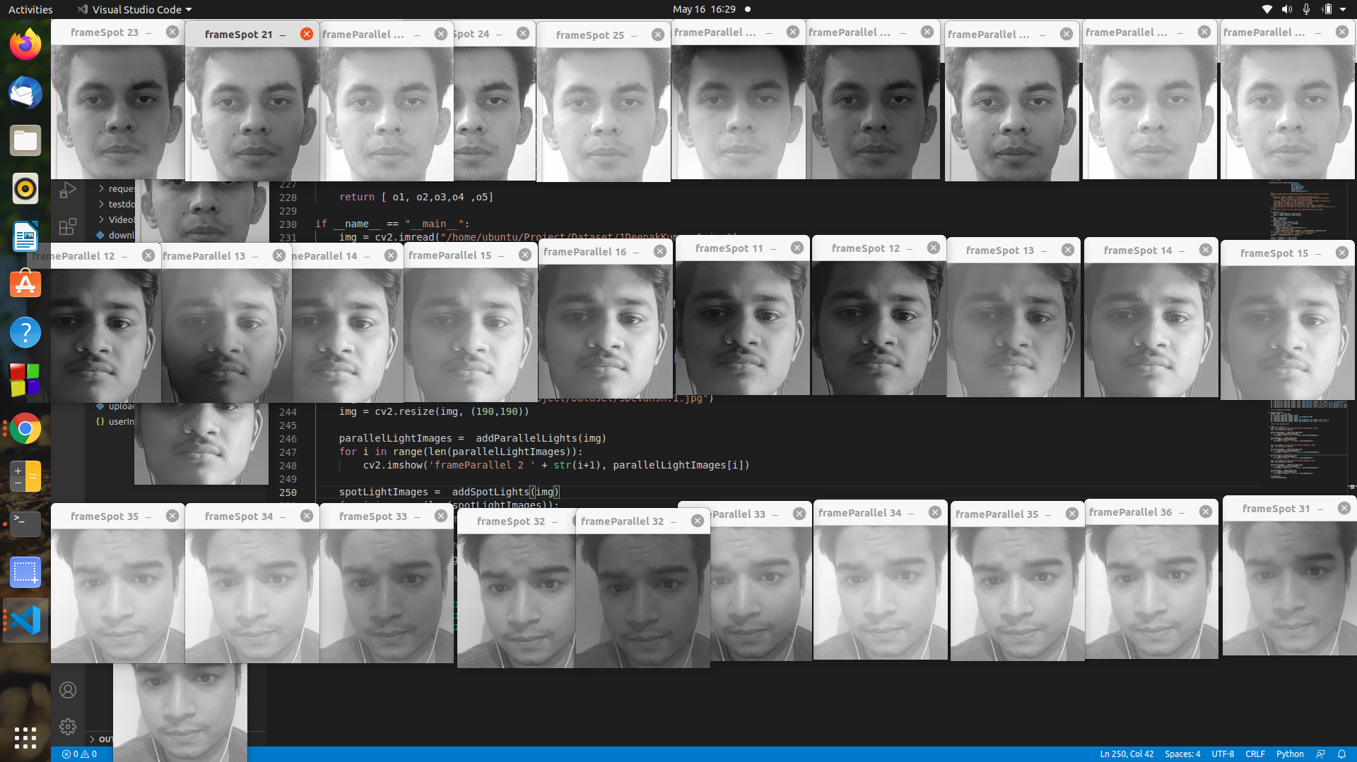
DATA AUGMENTATION

Slide 15
TIMELINE CHART
Hardware resource planning
Resource purchasing
Initializing microprocessor
Raspberry-trainer deployment
Raspberry-firebase integration
Adding alert
interaction
modules
Facial data
collection code
Recognition trainer modelling
Trainer recognition testing
Model-firebase
interaction
Evaluation
phase
End
Application UI
Firebase integration
Connecting
trainer-firebase -application
Realtime database creation
Populating
database
15th Jan
15th Feb
15th Mar
1-5 Apr
15-20 Apr
25-30th Apr
5-10th May

Slide 16
Limitation of the Minor Project
Raspberry Pi has only 1Gb ram because of that it’s not able to train the model with high dataset
ML Model recognize the images with only 74% accuracy
Dependency on the cloud server i.e; without the internet new users can’t be added.
End users can not receive notification if the user's mobile or Raspberry Pi have no access to the internet.
Project is not completely immune to exception handling.

Slide 17
Future Work
Increasing ML Model efficiency
Manage code more efficient by following Architecture such as MVC
Handling exceptions with specificity.
Adding more functionality to the app such as live cam, Alarm alert

Slide 18
REFERENCES
Hussein, N. A., & Al Mansoori, I. (2017, September). Smart door system for home security using raspberry pi3. In 2017 International Conference on Computer and Applications (ICCA) (pp. 395-399). IEEE.
Anwar, S., & Kishore, D. (2016). IOT based smart home security system with alert and door access control using smart phone. International Journal of Engineering Research & Technology (IJERT), 5(12), 504-509.
Desai.S, Pawar.D.V ,(2019,June).Smart Door Security System using Raspberry Pi with Telegram . In International Research Journal of Engineering and Technology (IRJET) (Volume :06 Issue:06).

